Slide 1

Health Care of the Community

Slide 2
Concept of health care
Health is influenced by multiple factors:
Adequate food, housing, sanitation
Healthy lifestyles and environmental safety
Control of communicable diseases
Health care is defined as: “Services provided to individuals or communities by agents of the health services or professions for the purpose of promoting, maintaining, monitoring, or restoring health” – WHO
Encompasses preventive, promotive, curative, and rehabilitative services

Slide 3

Medical Care vs Health Care & Public Responsibility
Medical care is:
A subset of health care
Direct services by physicians (e.g., hospital or domiciliary care)
Health care ≠ Medical care
Health care includes broader determinants and multisectoral actions
Health care as a public right:
Recognized by most governments and included in constitutions
In India, health care is primarily a governmental function, ensuring equal access for all citizens

Slide 4
Health system : Services
Role & Organization
Purpose:
To meet the health needs of the community using available knowledge and resources
Contextual Variability:
Health services cannot have a fixed role due to differing socio-economic patterns across countries
Delivery Mechanism:
Provided through the health system
Involves organizational and managerial structures

Slide 5
Key Themes in Modern Health Service Delivery
Population-Wide Coverage
Services must meet the needs of entire populations, not select groups
Must include preventive, curative, and rehabilitative services
Considered part of the basic social services of a country
Primary Health Care (PHC) Approach
Most effective strategy for rural and underserved populations
Supported by a strong referral system
Aligned with global policy: “Health for All by 2000 A.D.”

Slide 6

WHO: Health for All by the Year 2000
Launched by the WHO in 1978 through the Alma-Ata Declaration
Goal: Universal access to essential healthcare services by the year 2000
Emphasized primary healthcare, equity, and community participation
Despite falling short globally, it laid the foundation for future global health goals, including Universal Health Coverage

Slide 7
HEALTH FOR ALL
Launched by WHO in 1977 at the 30th World Health Assembly
Core Principle: Equity — equal health status for all individuals and nations through equitable distribution of health resources
“Attainment of a level of health that will enable every individual to lead a socially and economically productive life.” – WHO, 1977
Declared a major global social goal

Slide 8
Alma-Ata (1978) & Global Mobilization
Alma-Ata Conference (1978) reaffirmed HFA as a universal goal
Primary Health Care (PHC) identified as the most effective strategy
Especially for rural and underserved urban populations
PHC must be accessible, acceptable, affordable, with full community participation
All governments were urged to:
Formulate national policies, strategies, and plans
Integrate PHC within the national health system
Develop country-specific indicators based on local contexts

Slide 9
Global & National Strategies for HFA
1981: WHO launched a Global Strategy for Health for All
Broad yet flexible framework adaptable by member states
Led to development of national and regional strategies
12 Global Indicators introduced by WHO to assess progress
Examples:
Minimum life expectancy: 60 years
Maximum infant mortality rate (IMR): 50 per 1000 live births
These indicators serve as benchmarks to measure national efforts toward achieving HFA by 2000

Slide 10
National Strategy for Health for All (HFA) by 2000
India signed the Alma-Ata Declaration (1978), committing to achieve HFA by 2000 AD
Two key reports shaped national strategy:
ICSSR-ICMR Report – “Health for All: An Alternative Strategy”
MOHFW Working Group Report – “Health for All by 2000 AD”
Both examined how to deliver Primary Health Care (PHC) effectively in the Indian context
These led to the National Health Policy (NHP) of 1983, India's first formal health policy
Reaffirmed the HFA objective
Aligned with WHO & Alma-Ata principles
Laid down specific, time-bound health goals

Slide 11
Key Goals of India’s National Health Policy (1983)
Indicator | 1978 Baseline | Target by 2000 | Current
Infant Mortality Rate (IMR) | 125 / 1000 | < 60 / 1000 | 27 / 1000 (SRS 2021)
Life Expectancy at Birth | 52 years | 64 years | 70.1 years (69.4 ♂, 71.0 ♀) – 2022
Crude Death Rate (CDR) | 14 / 1000 | 9 / 1000 | 6.0 / 1000 (SRS 2020)
Crude Birth Rate (CBR) | 33 / 1000 | 21 / 1000 | 19.5 / 1000 (SRS 2020)
Net Reproduction Rate (NRR) | > 1 | 1 | ~1.0
Rural Potable Water Coverage | Incomplete | 100% coverage | 97% of rural households (Jal Jeevan Mission, 2024)

Slide 12
Shift in Focus — Community & Equity
Community Participation
Integral across all domains: treatment, prevention, and promotion
Paradigm Shift
From medical care → health care
From urban focus → rural focus
Emphasizes equity, inclusiveness, and people-centered service delivery

Slide 13
Emergence of Primary Health Care – Alma-Ata (1978)
Alma-Ata Conference (USSR, 1978) introduced a broader, community-focused concept
“Essential health care made universally accessible to individuals and acceptable to them, through their full participation and at a cost the community and country can afford.” – WHO, 1978
Core Principles:
Universal accessibility
Community participation
Affordability & sustainability

Slide 14
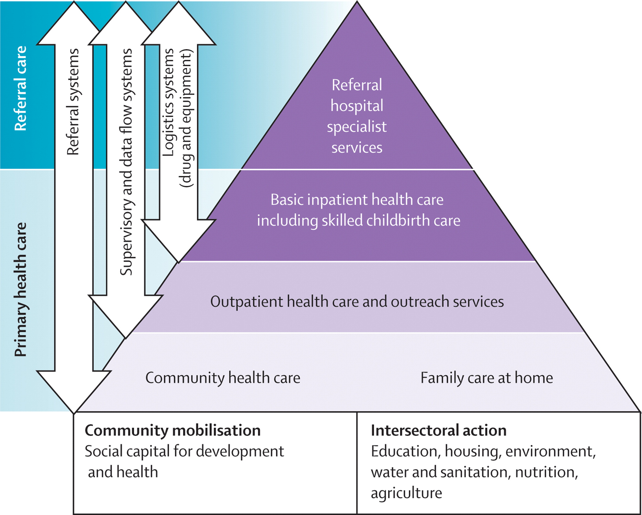
Alma Ata declarartion

Slide 15
Levels of Health Care
Health care services are delivered at three levels:
Primary Care
Secondary Care
Tertiary Care
These levels represent varying degrees of complexity and types of health needs.

Slide 16
Primary Care Level
First point of contact for individuals, families, and communities
Provides essential ("primary") health care
Most health problems are prevented, treated, or managed at this level
Delivered through:
Primary Health Centres (PHCs)
Sub-Centres
Staff: MPHWs, ANMs, ASHAs, AWWs, trained dais, village health guides
Functions:
Basic curative, preventive, promotive, and rehabilitative services
Acts as a cultural bridge to organized health systems
Strengthened under “Health for All by 2000 A.D.”

Slide 17
Secondary Care Level
Next level after primary care
Deals with more complex health issues
Acts as the first referral level
Provided through:
District Hospitals
Community Health Centres (CHCs)
Offers specialist care, diagnostic services, and inpatient care.

Slide 18
Tertiary Care Level
Most specialized level of care
Requires advanced facilities and highly trained specialists
Delivered at apex institutions such as:
Medical College Hospitals
All India Institutes (e.g., AIIMS)
Regional & Specialized Hospitals

Slide 19
Referral System: A Critical Function
Enables two-way exchange:
Upward referral for specialized care
Downward referral for follow-up and continuity
Builds patient trust and strengthens the system
In India and other developing countries, referral systems are often weak and underdeveloped

Slide 20
CHANGING CONCEPTS
Context & Emergence of New Approaches
Post‑independence pledge: Developing countries, including India, committed to rapid health improvement.
Multiple approaches to health‑care delivery evolved to meet population needs.
Introduction of “Comprehensive Health Care”—first articulated by the Bhore Committee (1946).

Slide 21
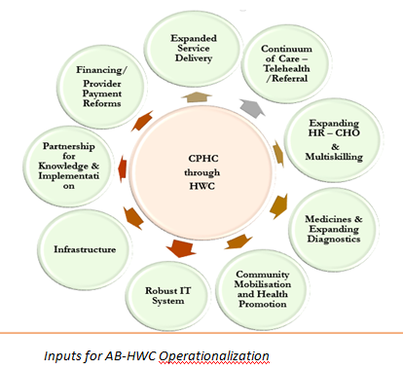
Comprehensive health care

Slide 22
Evolution & Global Acceptance of Primary Health Care
Earlier terms included:
Basic health services
First contact care
Services by generalists
Broadened perspective post-Alma-Ata:
Valid for all countries, regardless of development status
Recognized as key to “Health for All by 2000 AD”
Forms the foundation of modern national health systems globally

Slide 23
Basic Health Services
Definition: “A network of coordinated peripheral and intermediate health units performing essential health functions with competent personnel.” — UNICEF/WHO, 1965
Key Features:
Focus on essential functions
Delivered through professional and auxiliary personnel
Emphasized operational efficiency over breadth
Limitations (shared with comprehensive health care):
Lack of community participation
Poor intersectoral coordination
Neglect of socio-economic determinants

Slide 24
Essential Elements of Primary Health Care
Primary health care ensures accessible, affordable, and community-based health services.
The 8 core elements include:
Health Education
Food & Nutrition Promotion
Safe Water & Sanitation
Focused on prevailing health problems and prevention strategies
Ensuring adequate food supply and proper nutrition
Access to clean drinking water and basic sanitation facilities

Slide 25
Maternal & Child Health + Family Planning – Comprehensive care across pregnancy, childbirth, child-rearing, and reproductive health
Immunization – Protection against major infectious diseases (e.g., measles, polio, TB)
Disease Control – Prevention and control of locally endemic diseases
Essential Treatment – Appropriate care for common illnesses and injuries
Essential Drugs – Availability and rational use of affordable, quality medications

Slide 26
Principles of Primary Health Care
“Health by the people, for the people”
Goal: Acceptable level of health for every individual through equity, participation, coordination, and appropriate technology
Four core principles to operationalize PHC:
Equitable distribution
Community participation
Inter‑sectoral coordination
Appropriate technology

Slide 27
Equitable Distribution
Equity = access for all, irrespective of ability to pay, place of residence, class, or gender
Current imbalance: ¾ of health budgets spent in cities, while ¾ of India’s population lives in rural areas → social injustice
PHC strategy shifts the “centre of gravity” from urban hospitals to community‑based care near people’s homes
Targets needy & vulnerable groups in rural areas and urban slums
Addresses barriers of inaccessibility & affordability to correct historical neglect

Slide 28
Community Participation
Individuals, families, communities actively plan, implement, and maintain their own health services
Universal PHC cannot be achieved without local involvement
Relies on local resources: manpower, money, materials
Indian innovations
Village Health Guides & Trained Dais
ASHA & Anganwadi Workers chosen by their communities
Benefits: overcomes cultural/communication barriers, boosts acceptability, nurtures ownership of health programmes

Slide 29
Inter‑sectoral Coordination
Health determinants span beyond the health sector → need cooperation with:
Agriculture & Animal Husbandry (food security)
Education (literacy, health behaviour)
Public Works & Housing (water, sanitation)
Industry & Communications (healthy workplaces, information flow)
Alma‑Ata mandate: National development policies must embed health goals
Requires political will, joint planning, resource re‑allocation, and enabling legislation to avoid duplication and maximise impact

Slide 30
Appropriate Technology
Definition: Scientifically sound, locally adaptable, culturally acceptable, affordable, and maintainable by the community
Contrasts with costly, “luxury” tertiary technologies that drain budgets without meeting local needs
Examples of appropriate solutions:
Oral Rehydration Solution (ORS) for diarrhoea
Village standpipes vs. expensive house‑to‑house water connections
Embodies self‑reliance and sustainable use of limited resources
PHC vs. past models: shifts from top‑down service delivery to people‑centred approaches emphasising equity, participation, coordination, and technology suited to local realities

Slide 31
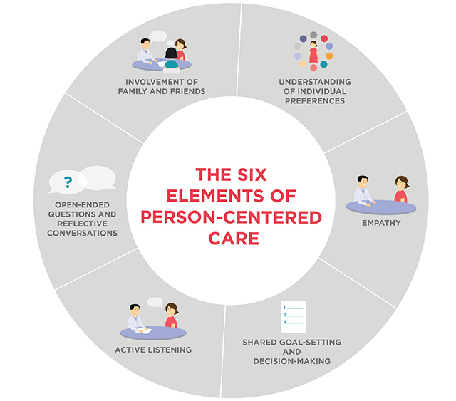
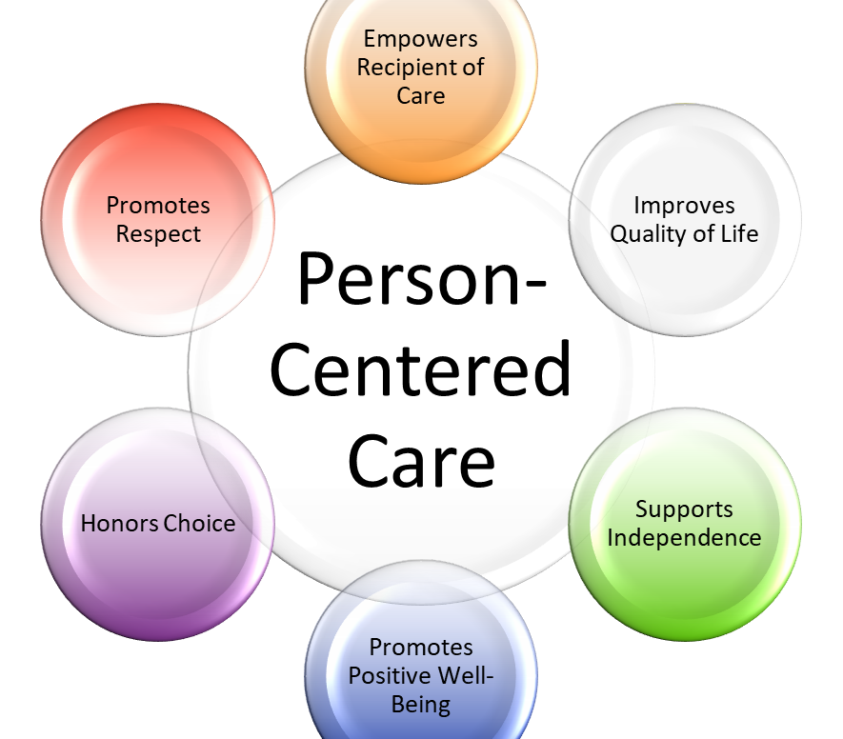
People centred approach

Slide 32
Millennium Development Goals (MDGs)
Adopted in 2000 by 189 countries at the UN Millennium Summit, New York
Framed as part of the UN Millennium Declaration
Aimed at poverty eradication and sustainable development, with a target year of 2015
8 MDGs established as a global framework for action and accountability
MDGs placed health at the heart of development, encouraging integrated efforts across education, environment, gender, and health

Slide 33
Health-Related MDGs & Impact on Policy
Health Focus in MDGs:
3 of 8 Goals
8 of 18 Targets
18 of 48 Indicators
Key Health-Related Goals:
Reduce child mortality
Improve maternal health
Combat HIV/AIDS, malaria, and other diseases

Slide 34
Other interconnected goals:
Eradicate extreme poverty & hunger
Ensure environmental sustainability
Promote gender equality
Achieve universal primary education
Develop global partnership for development
Policy Impact:
Guided national health strategies focused on the poor
Supported monitoring and evaluation of health systems
Encouraged tackling cross-cutting issues in health and development

Slide 35
HEALTH CARE DELIVERY: Challenges
Many countries struggle to ensure universal access and utilization of health care services
Traditional reliance on large hospitals has major limitations:
Serve only a small urban population within limited radius
Services are largely curative, not comprehensive
High maintenance costs with limited community impact
Critique: These hospitals have become “ivory towers of disease,” not effective public health institutions
Solution: Explore alternative, cost-effective, community-based models tailored to rural needs

Slide 36
Need for Alternative Models
Rising costs and inequitable access necessitate new models
Objectives of alternative models:
Be inexpensive yet effective
Provide essential care suited to rural populations
Address comprehensive needs, not just curative ones
Models should be:
Planned based on community needs
Use available knowledge & resources efficiently
Ensure equitable distribution and accessibility of services

Slide 37
Health Care Delivery Model – Inputs to Outputs
Inputs
Health needs and demands of the community
Require setting priorities due to limited resources
Health Care Services
Should be comprehensive and community-based
Designed using available resources and local knowledge
Health Care System
The management/organizational sector
Responsible for delivering services effectively
Outputs
Improved health indicators:
Lives saved, diseases prevented, cases treated,
Mortality reduced, life expectancy increased
These models are actively employed to improve health care planning and delivery in both developing and developed contexts.

Slide 38
Health Status and Health Problems
Community Diagnosis – Assessing Health Status
Definition: Community diagnosis is the first step in planning health services — involves assessing the health status and health problems of a population.
Purpose:
Identify priority health problems
Guide resource allocation and intervention planning
Data Required for Analysis:
Morbidity and mortality statistics
Demographic profile (age, sex, population growth, etc.)
Environmental conditions affecting health (water, sanitation, pollution)
Socio-economic factors (income, education, occupation)

Slide 39
Factors in Community Diagnosis & Priority Setting
Additional Determinants:
Cultural practices, attitudes, beliefs impacting health behavior
Availability of medical and health services
Availability of other support services (e.g., transportation, education)
Outcome of Community Diagnosis:
Holistic picture of the community’s health situation
Enables prioritization of problems based on:
Severity
Size of affected population
Feasibility of intervention
Availability of resources

Slide 40

Demographic Profile – India
Key Concerns:
Population explosion remains a significant public health and development challenge
Demographic Features:
Large population base
High fertility: Elevated birth rates and large family sizes
Low or declining mortality, contributing to population growth
Youth-dominated population: ~28% below 15 years of age
High illiteracy: ~34.62% are illiterate → slower decline in fertility
High dependency ratio (2018): 50.5%
Every working person supports almost one dependent

Slide 41
Mortality Trends in India – Improvements Over Time
Significant Progress in Past Decades:
Crude Death Rate (CDR) declined from 21 (1965) → 6.0 (2020)
Life Expectancy at Birth (2020):
Males: 67 years
Females: 70 years
Decline in mortality from major infectious diseases: Cholera, Tuberculosis, Malaria

Slide 42
Persisting Mortality Challenges in India
Infant Mortality Rate (IMR), 2018:
India: 32 per 1000 live births
World average: 29
Developed countries: as low as 5
State-wise IMR (2018):
Kerala: Lowest – 7 per 1000
Madhya Pradesh: Highest – 48 per 1000
Global Comparison:
India’s life expectancy (~68 years) lags 12–15 years behind developed nations (71–80 years)
Despite improvements, India's mortality indicators highlight disparities and unmet needs, particularly in rural areas and less developed states.

Slide 43
Health problems
1. Communicable disease problems;
2. Non-communicable disease problems;
3. Nutritional problems;
4. Environmental sanitation problems;
5. Medical care problems;
6. Population problems.

Slide 44

Thanks

